Slide 1
Introduction to Regression
Chapter 16

Slide 2
Introduction to Linear Equations and Regression
The Pearson correlation measures the degree to which a set of data points form a straight line relationship.
Regression is a statistical procedure that determines the equation for the straight line that best fits a specific set of data.
The resulting straight line is called the regression line.

Slide 3
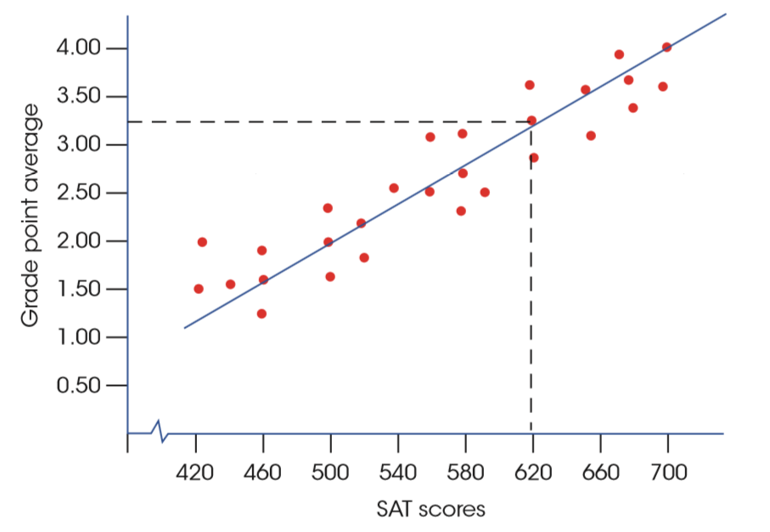
A One-to-One Relationship
Notes:
FIGURE 16.1 The relationship between SAT scores and college GPA with a line drawn through the middle of the data points. The line defines a precise one-to-one relationship between each X value (SAT score) and a corresponding Y value (GPA).

Slide 4
Linear Equations and Regression
Any straight line can be represented by an equation of the form Y = bX + a, where b and a are constants.
The value of b is called the slope constant and determines the direction and degree to which the line is tilted.
The value of a is called the Y-intercept and determines the point where the line crosses the Y-axis.

Slide 5
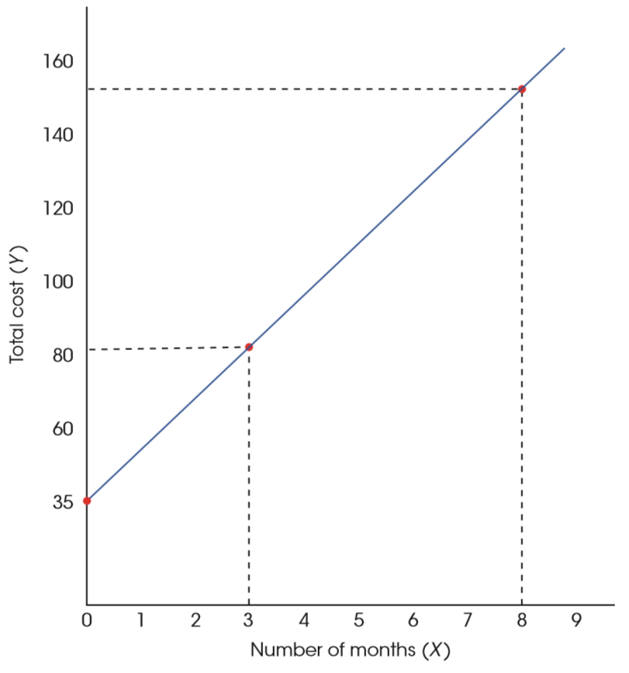
Linear Equations and Regression (cont'd.)
Notes:
FIGURE 16.2 The relationship between total cost and number of months of gym membership. The gym charges a $35 membership fee and $15 per month. The relationship is described by a linear equation Y = 15X + 35 where Y is the total cost and X is the number of months.

Slide 6
Least Squares Solution
To determine how well a line fits the data points, the first step is to define mathematically the distance between the line and each data point.
Using the formula Y = bX + a, it is possible to find the predicted value of Ŷ (“Y hat”) for any X.
The error (distance) between the predicted value and the actual value can be found by: Y - Ŷ
Because some distances may be negative, each distance should be squared so that all measures are positive.

Slide 7
Least Squares Solution (cont’d.)
The total error between the data points and the line is obtained by squaring each distance and then summing the squared values.
Total squared error = Ʃ(Y – Ŷ)²
The regression equation is designed to produce the minimum sum of squared errors.
Best fitting line has the smallest total squared error: the line is called the least-squared-error solution and is expressed as: Ŷ = bX + a

Slide 8
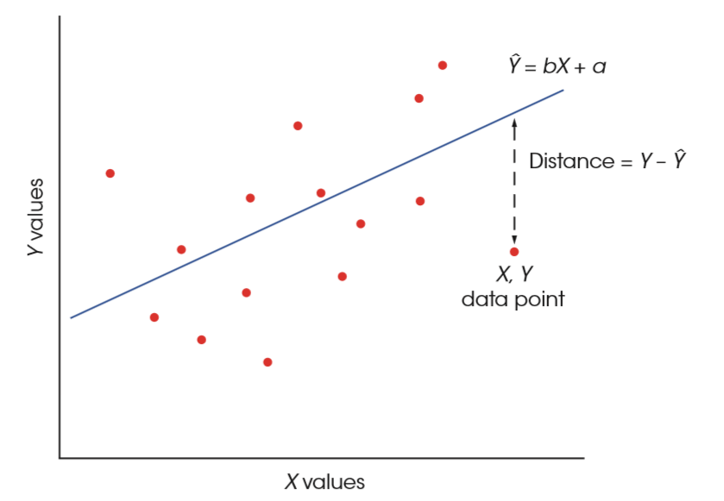
The Regression Line
Notes:
FIGURE 16.3 The distance between the actual data point (Y) and the predicted point on the line (Ŷ) is defined as Y – Ŷ. The goal of regression is to find the equation for the line that minimizes these distances.

Slide 9
The Regression Line (cont’d.)
The equation for the regression line is given by:
Ŷ = bX + a
where b = SP / SS_{x} or
b = r (s_{y} / s_{x}) and
a = M_{Y} – bM_{X}

Slide 10
Using the Regression Equation for Prediction
Although regression equations can be used for prediction, a few cautions should be considered whenever you are interpreting the predicted values.
The predicted value is not perfect (unless r = +1.00 or –1.00).
The regression equation should not be used to make predictions for X values that fall outside the range of values covered by the original data.

Slide 11
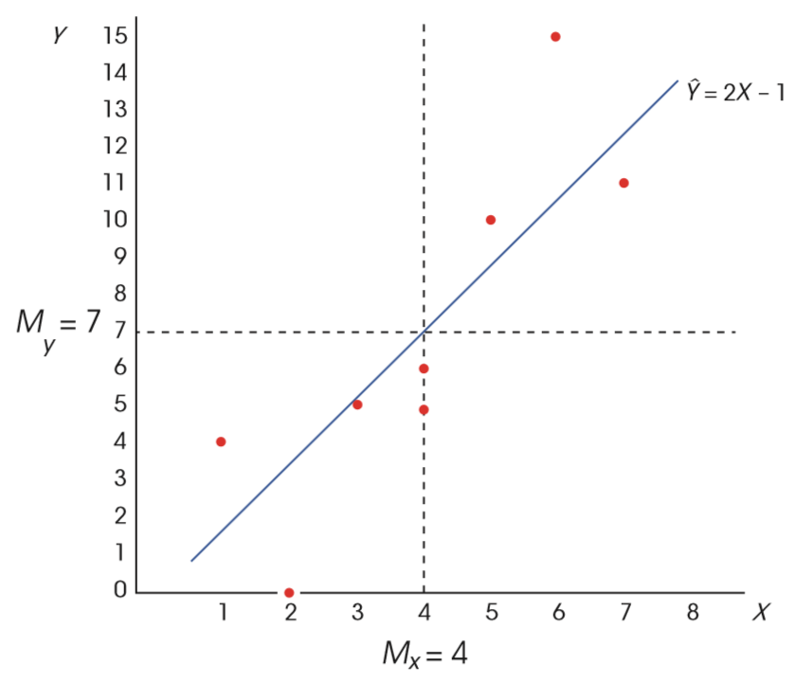
Using the Regression Equation for Prediction (cont’d.)
Notes:
FIGURE 16.4 The X and Y data points and the regression line for the n = 8 pairs of scores in Example 16.1.

Slide 12
Standardized Form of the Regression Equation
Occasionally, researchers standardize the scores by transforming the X and Y values into z-scores before finding the regression equation.
The resulting equation is often called the standardized form of the regression equation and is greatly simplified compared to the raw-score version.
ẑ_{Y} = (beta)z_{X}

Slide 13
Standardized Form of the Regression Equation (cont’d.)
First notice that we are now using the z-score for each X value (z_{X}) to predict the z-score for the corresponding Y value (z_{Y}).
Also, note that the slope constant that was identified as b in the raw-score formula is now identified as beta.
Because both sets of z-scores have a mean of zero, the constant a disappears from the regression equation.

Slide 14
Standardized Form of the Regression Equation (cont’d.)
Finally, when one variable, X, is being used to predict a second variable, Y, the value of beta is equal to the Pearson correlation for X and Y.
Thus, the standardized form of the regression equation can also be written as
ẑ_{Y} =rz_{X}

Slide 15
The Standard Error of Estimate and Analysis of Regression
A regression equation allows you to make predictions, but does not provide any information about the accuracy of the predictions.
To measure the precision of the regression, it is customary to compute a standard error of estimate.
The standard error of estimate gives a measure of the standard distance between the predicted Y values on the regression line and the actual Y values in the data.

Slide 16
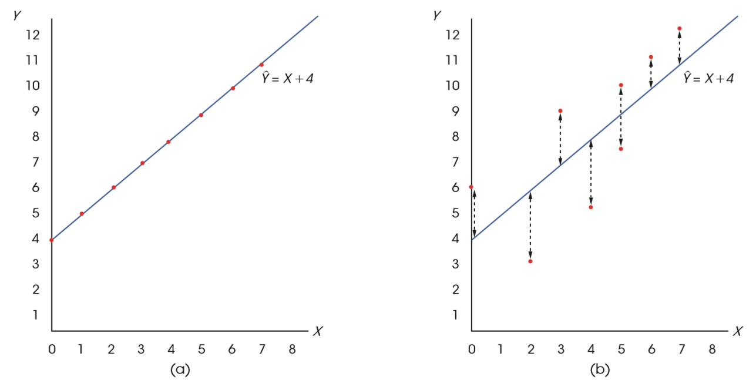
Scatter Plots and Regression
Notes:
FIGURE 16.5 (a) A scatter plot showing data points that perfectly fit the regression line defined by Ŷ = X + 4. Note that the correlation is r = +1.00. (b) A scatter plot for another set of data with a regression equation of Ŷ = X + 4. Notice that there is error between the actual data points and the predicted Y values on the regression line.

Slide 17
The Standard Error of Estimate and Analysis of Regression (cont'd.)
The unpredicted variability can be used to compute the standard error of estimate, which is a measure of the average distance between the actual Y values and the predicted Y values.

Slide 18
Relationship between the Standard Error and the Correlation
The squared correlation, r², is called the coefficient of determination because it determines what proportion of the variability in Y is predicted by the relationship with X.
Because r² measures the predicted portion of the variability in the Y scores, we can use the expression (1 – r²) to measure the unpredicted portion.

Slide 19
Analysis of Regression
In the same way that we tested the significance of a Pearson correlation, we can test the significance of the regression equation.
H₀: the slope of the regression equation is zero

Slide 20
Analysis of Regression (cont’d.)
Notes:
FIGURE 16.6 The partitioning of SS and df for analysis of regression. The variability for the original Y scores (both SS and df) is partitioned into two components: (1) the variability that is predicted by the regression equation and (2) the residual variability.

Slide 21
Analysis of Regression (cont’d.)
The process of testing the significance of a regression equation is called analysis of regression and is very similar to the analysis of variance (ANOVA).
As with ANOVA, the regression analysis uses an F-ratio to determine whether the variance predicted by the regression equation is significantly greater than would be expected if there were no relationship between X and Y.

Slide 22
Analysis of Regression (cont’d.)
The F-ratio is a ratio of two variances, or mean square (MS) values, and each variance is obtained by dividing an SS value by its corresponding degrees of freedom.
The numerator of the F-ratio is MS_{regression}, which is the variance in the Y scores that is predicted by the regression equation.
This variance measures the systematic changes in Y that occur when the value of X increases or decreases.

Slide 23
Analysis of Regression (cont’d.)
The denominator is MS_{residual}, which is the unpredicted variance in the Y scores.
This variance measures the changes in Y that are independent of changes in X.

Slide 24
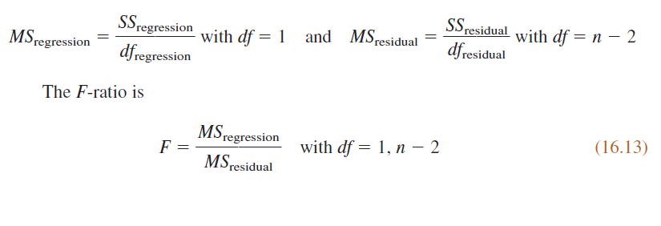
Introduction to Linear Regression

Slide 25
Significance of Regression and Significance of the Correlation
In situation with a single X variable and a single Y variable, testing the significance of the regression equation is equivalent to testing the significance of the Pearson correlation.
Therefore, whenever the correlation between two variables is significant, you can conclude that the regression equation is also significant.
Similarly, if a correlation is not significant, the regression equation is also not significant.

Slide 26
Introduction to Multiple Regression with Two Predictor Variables
In the same way that linear regression produces an equation that uses values of X to predict values of Y, multiple regression produces an equation that uses two different variables (X₁ and X₂) to predict values of Y.
The equation is determined by a least squared error solution that minimizes the squared distances between the actual Y values and the predicted Y values.

Slide 27
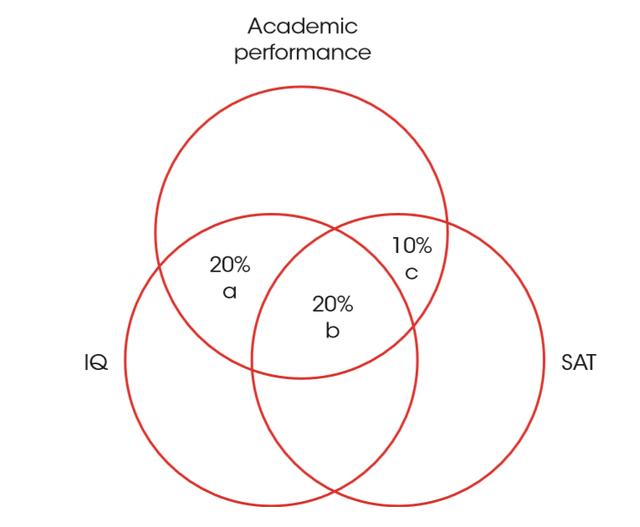
Predicting a Variance
Notes:
FIGURE 16.7 Predicting the variance in academic performance from IQ and SAT scores. Note that IQ predicts 40% of the variance in academic performance but adding SAT scores as a second predictor increases the predicted portion by only 10%.

Slide 28
Multiple Regression with Two Predictor Variables
For two predictor variables, the general form of the multiple regression equation is:
Ŷ= b₁X₁ + b₂X₂ + a
The ability of the multiple regression equation to accurately predict the Y values is measured by first computing the proportion of the Y-score variability that is predicted by the regression equation and the proportion that is not predicted.

Slide 29
R² and Residual Variance
For a regression with two predictor variables:
As with linear regression, the unpredicted variability (SS and df) can be used to compute a standard error of estimate that measures the standard distance between the actual Y values and the predicted values

Slide 30
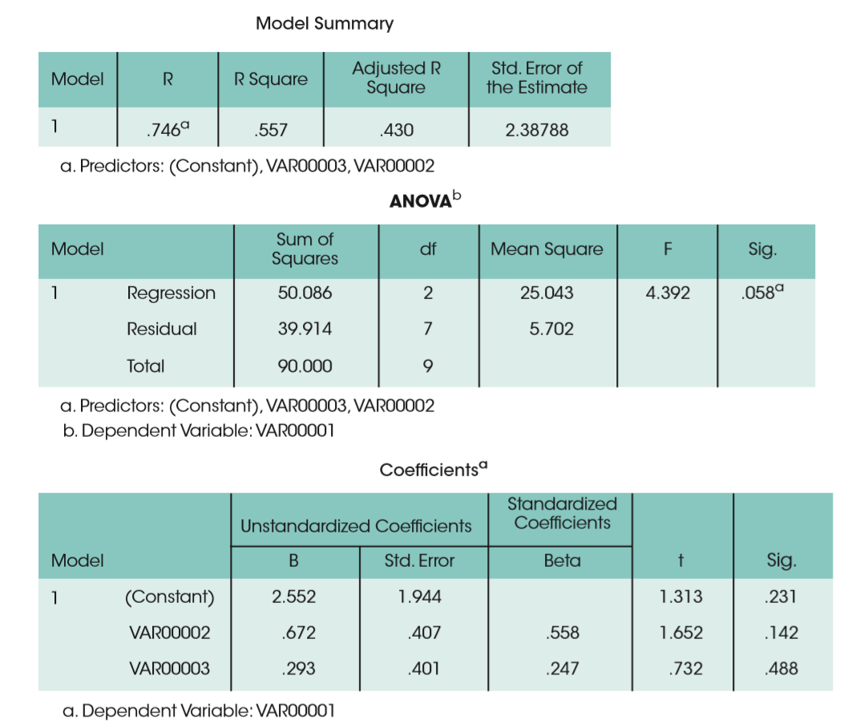
SPSS Output
Notes:
FIGURE 16.8 The SPSS output for the multiple regression in Example 16.6.

Slide 31
Standard Error of Estimate
To find the standard error of estimate for either linear regression or multiple regression, we begin with SS_{residual}.
For linear regression with one predictor, SS_{residual} = (1 – r²)SS_{Y} and has df = n – 2.
For multiple regression with two predictors, SS_{residual} = (1 – R²)SS_{Y} and has df = n – 3.

Slide 32
Standard Error of Estimate (cont’d.)
In each case, we can use the SS and df values to compute a variance or MS_{residual}.
MS_{residual} = SS_{residual} / df

Slide 33
Testing the Significance of the Multiple Regression Equation
Just as we did with the single predictor equation, we can evaluate the significance of a multiple-regression equation by computing an F-ratio to determine whether the equation predicts a significant portion of the variance for the Y scores.
The total variability of the Y scores is partitioned into two components, SS_{regression} and SS_{residual}.
With two predictor variables, SS_{regression} has df = 2, and SS_{residual} has df = n – 3.

Slide 34
Evaluating the Contribution of Each Predictor Variable
In addition to evaluating the overall significance of the multiple-regression equation, researchers are often interested in the relative contribution of each of the two predictor variables.
In the standardized form of the regression equation, the relative size of the beta values is an indication of the relative contribution of the two variables.

Slide 35
Multiple Regression and Partial Correlations
Multiple regression provides an alternative procedure for accomplishing the goals or partial correlations.
Specifically, the regression analysis evaluates the contribution of each predictor variable after the influence of the other predictor has been considered.
Thus, you can determine whether each predictor variable contributes to the relationship by itself or simply duplicates the contribution already made by another variable.

